Slide 1
TSC Review : New Repo for components-fe
Name
02-08-2021

Slide 2
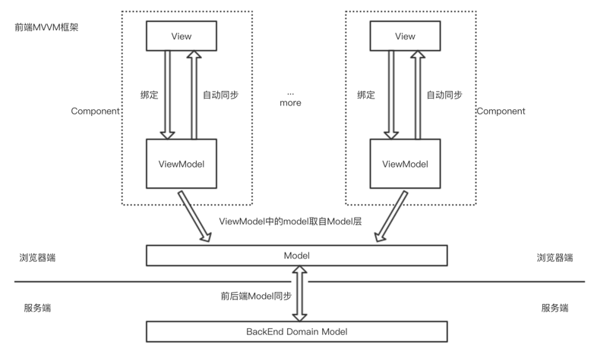
Details of the New Repo
New repo name : https://gitee.com/edgegallery/eg-view.git
Purpose :
将可复用的功能抽象成组件，各模块开发者基于组件进行开发
组件主题色调、样式归一化，可减少不同平台组件样式不一致问题，降低代码维护成本
组件能力可裁剪，支持按需引用.
Type: Open
Owner and Responsible Project Team/Working Group:
Owner Email: zhouwenjing, 942517636@qq.com;
PT/WG Name : developer
Committer and contributor:
Emails: zhouwenjing, 942517636@qq.com
Target EdgeGallery Version: v1.1.0
POC测试
Date of review in Architecure Group: 12-15-2020

